Slide 1
General PTO Meeting
November 7, 2022

Slide 2
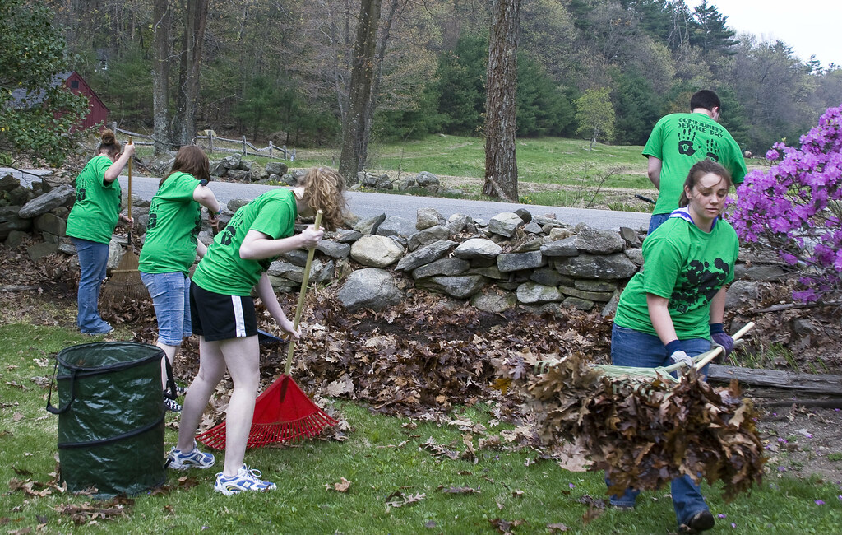
Service Hours
High School: Minimum of 25
Middle School: Minimum of 10
*These are separate from the requirements of other clubs and organizations.

Slide 3
Service Hours
SIMPLY PUT
BENEFIT
Volunteering in the community
Combines academic learning with personal and social development
WHY
HOW
Stronger students = stronger community
Use the Advisory website
Document on service learning log

Slide 4
HOW DO I CHOOSE MY SERVICE?
Students are encouraged to choose an area they are passionate about and spend time there
Colleges would rather see students focusing on one or two areas instead of "just fulfilling a requirement"

Slide 5
Common Questions
What is Allowed?
The sky is the limit here...
Find a passion
Any community service performed at CMS must be approved by Dr. Ash
What is not Allowed?
Things that the student "should do" already
Examples include – working concessions for my team, babysitting a sibling, helping a grandparent, mowing my lawn
Double Dipping
Double dipping is not allowed
For example, if the student earns ten hours in Beta Club, those hours do not count for our school obligation through Advisory
Awards
Annual community service award – 30 hours for middle school and 75 hours for high school (must be submitted by April 5th)
Other scholarships and awards are available from time to time

Slide 6
COMMON EXAMPLES
Local library or animal shelter
Volunteer at a former school
Political campaigns
Starting a non-profit
A non-profit organization
Mow a neighbor's yard for free
Work in a neighbor's landscaping for free
Pick up trash in a public park
Organize collection drives
9/11 day or service; MLK day of service

Slide 7
HOW TO REPORT THE HOURS
Get a log form from your Advisory teacher or the CMS website (Academics-Advisory)
Volunteer, fill out the form, round to the nearest half hour, and have an adult sign off confirming that you worked the hours
Parents/grandparents/guardians may NOT sign off on the forms
Return the form to the Advisory teacher by Wed, April 5, 2023

Slide 8
Student Resumes
What to include and when?
Information to include and not include?
Benefits of having one?

Slide 9
Types of Classes at Central Magnet & Testing

Slide 10
Types of classes at CMS
Advanced Placement
Dual Enrollment
Honors &
ADVANCeD
HONORS
State Standards
College Board/AP
College Class
Could have an EOC
3 extra points
AP Exam at end of year
5 extra points if you take the exam
Sign Ups for fall are complete
MTSU
4 extra points

Slide 11
End of Year Testing
TN READY
Based on State Standards
TCAP: TN Comprehensive Assessment Program (Middle School)
EOC: End of Course (High School)
Usually begins mid-April, window to complete.
Computer based this year.
If scores return in time, 15% of second semester grade.
AP
College Board test at the end of an Advanced Placement class. Most often leads to college credit. Must sit for exam for 5 points. Use AP Classroom.
FINALS
Any non-tested class will have a final which counts 15% of the second semester grade. Students can be exempt based on grades and absences.

Slide 12
College ENTRANCE
ACT/SAT
PSAT: Preliminary SAT/National Merit Scholarship Qualifying Test
Junior year is when you can qualify for National Merit. All other grades take for practice. Sign-ups at school late August through mid-September.
Best practice is through Khan Academy.
Two different college entrance exams. No SAT during school day. Can sign up for both on a Saturday. We are not always a site. Free ACT for juniors in spring and seniors in fall during the school day. We practice with ACT CERT and Juniors will take part in an ACT Boot Camp.
ACT CERT students can pull up their scores, results, and remediation and share with parents.

Slide 13
When to take ACT
Toward the end of the sophomore year is a good time to take the ACT for a baseline. They should continue to increase score opportunities throughout their junior year into first semester senior year. Remember, the score/gpa they have in August of senior year is what they will use to begin college applications.

Slide 14
Other TESTS
Case Assessment
This is a benchmark that state tested classes will take once each semester. It is the same across the county. Allows us to know how our students are progressing.
Both middle school and high school take Case Assessment.
MidtermS
All high school students take midterms. They are the last week of the semester and count 15% of their first semester grade.
YOUSCIENCE
This is not a test but an assessment. Given to 8th grade and 9th grade students to assess their career interests and strengths. Will be given in January.

Slide 15
Questions?
Guidance:
Kris Clary A-G
Katie McAdams H-O
Anna Grace Gerhart P-Z
Administration:
Dr. John Ash, Principal
Dr. Amy Guthrie, Asst. Principal
Michelle Huffman, Asst. Principal
Allen Nichols. Asst. Principal

